Slide 1
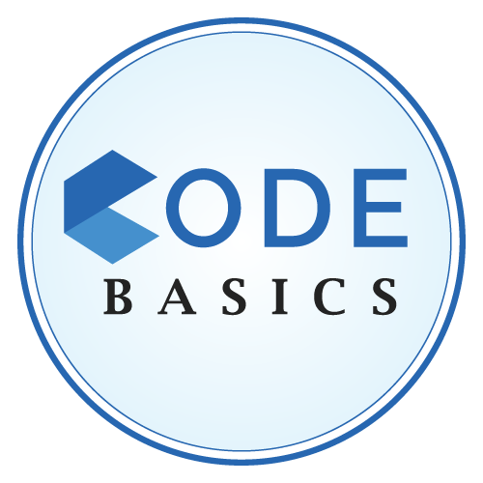
Codebasics Resume Challenge
November Month – Presented by : Azar Shaik

Slide 2


Company Background
AtliQo is one of the leading telecom providers in India and launched it’s 5G plans in May 2022 along with other telecom providers.

Slide 3

Problem Statement
The management noticed a decline in their active users and revenue growth post 5G launch in May 2022

Slide 4
Expectation
Provide a comparison report of KPIs between pre and post-periods of the 5G launch
Revenue Before/After 5G
ARPU Before/After 5G
Active Users Before/After 5G
Unsubscribed users Before/After 5G

Slide 5
Insights
At 425.69 crores, February had the highest Revenue Before 5G and was 20.13% higher than January, which had the lowest Revenue Before 5G at 354.37 crores.﻿
February had the highest Revenue Before 5G at 425.69, followed by March, April, and January
August accounted for 26.84% of Unsubscribed users After 5G.
Across all 4 Month, Unsubscribed users After 5G ranged from 16 to 19 lakhs.
﻿Sum of market share for PIO started trending up on Friday, April 1, 2022, rising by 1.99% (10.77) in 5 months.
At 489.55 crores, Mumbai had the highest Sum of revenue and was 1,452.16% higher than Raipur, which had the lowest Sum of revenue at 31.54 crores.
Mumbai accounted for 15.36% of Sum of revenue.
Across all 15 City, Sum of revenue ranged from 31.54 to 489.55 crores.

